Slide 1
Field Instructor Orientation to Field Education Spring 2022
UCF School of Social Work
Field Education Office

Slide 2
Welcome to all Field Instructors!
Social Workers Are Essential! Serving as a Field Instructor is your chance to represent yourself, your agency, and the field of social work. To make a difference & to assist with the sustainability and success of our future social workers.
This is an exciting time and an anxious time, especially given the climate in which students are entering field:
A time for healing and trauma recovery
A time for systematic changes
We are here to help you and provide you with the support, guidance and information to help everyone be successful!

Slide 3
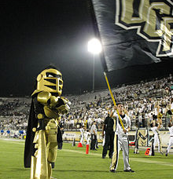
Field Education Faculty and Staff
Who is on your TEAM?
Dr. Matthew Theriot, PhD – Director of the School of Social Work
Robin Pisano, MSW – Director of Field Education
Cassandra Peters, LCSW –Faculty, Field Education
Iradly Roche, MSW–Faculty, Field Education
Jacquie Withers, LCSW-Assoc. Faculty, Field Education
Field Office
HS1 Building, Rm 236
407-823-5230

Slide 4
Important Dates-Spring 2022
Spring Semester Begins: January 10, 2022
Spring Semester Ends: April 25, 2022
Exam Week: April 27-May 3, 2022
Spring Break: March 6-13, 2022
LEAD Day: two-day event in early Spring. Students who attend are eligible to receive 16 field hours for attending. Dates – TBD (not publicized yet by NASW)

Slide 5
Full-Time BSW Students:
Complete a TOTAL of 420 hours at field placement:
Spring Semester: 28 hrs./week = 420 hours
Part-Time BSW Students:
Spring Semester: 17 hrs./week = 250 hours
Summer Semester: 14 hrs./week = 170 hours
Total = 420 hours

Slide 6
The elephant in the room: COVID 19 What does field look like in a post-covid world?
MOST but not ALL agencies are back to an office setting (some have maintained virtual options for clients).
Current CDC guidelines do not require masks/social distancing for vaccinated individuals
Students are instructed to follow your agency’s requirements.
Students are not to work with clients/patients who have suspected or confirmed COVID19

Slide 7
FREQUENTLY ASKED QUESTIONS:
What if I display symptoms of COVID19 or am in contact with someone with COVID 19 during my placement?
Seek healthcare, contact UCF Student Health Services, do not go to your field placement until discussed and a plan is developed with your field faculty member
What if I start having symptoms of COVID19 while at my field placement?
Tell your field instructor at the agency and you field liaison at UCF, you will be advised of the agency protocol to follow, seek healthcare as needed
What should I do if I test positive for COVID19?
Contact Health Services (for tracking purposes), your field supervisor and your seminar instructor.

Slide 8
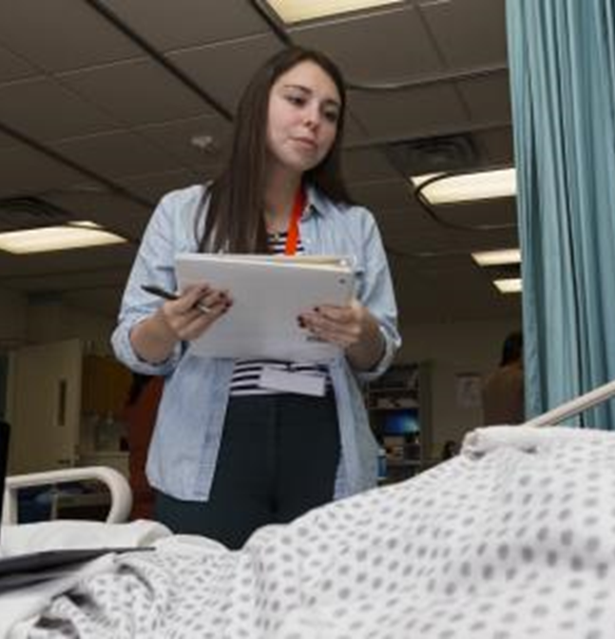
What will my Intern be doing?
BSW Student (Generalist Social Work):
(Full-time/Part-time)
Present themselves as Professionals in the field
Engage clients (& navigate difficult conversations)
Function as case managers
Assess needs and resources
Obtain resources and provide referrals
Evaluate resources and referrals
Develop and improve resources
Learn Cultural Humility & Cultural Competency
Understand the operations of a Non-Profit Agency
Learn how to become client advocates at the Micro and Macro levels
Understand policies that impact their clients at the individual & community levels

Slide 9
Accreditation standards in field education:
CSWE - Educational Policies and Accreditation Standards (EPAS 2015)
Demonstrate Ethical and Professional Behavior
Engage Diversity and Difference in Practice
Advance Human Rights and Social, Economic, and Environmental Justice
Engage in Policy Practice (Social workers understand that human rights and social justice, as well as social welfare and services, are mediated by policy and its implementation at the federal, state, and local levels)
Engage in Practice-informed Research and Research-informed Practice
Engage with Individuals, Families, Groups, Organizations, and Communities
Assess Individuals, Families, Groups, Organizations, and Communities
Intervene with Individuals, Families, Groups, Organizations, and Communities
Evaluate Practice with Individuals, Families, Groups, Organizations, and Communities
** Zoom Poll

Slide 10
Field seminar and field internship classes: An Integrated approach to field
Field Seminar - Course designed to provide material, assignments and discussions regarding the field placement experience
Will be graded with a letter grade
Field Internship – Course in which students are required to show that they have met the required number of field placement hours and a satisfactory evaluation.
Will be graded Satisfactory or Unsatisfactory

Slide 11
Questions:
Any questions so far regarding:
Hours needed
Important Dates (Fall or Spring)
COVID 19 policies
Intern role/duties

Slide 12
Roles in Field Education:
Field Office Faculty & Staff
Field Seminar Instructor
Field Agency Instructor
Task Supervisor

Slide 13
Field Office Faculty & Staff:
Interviews, recruits and establishes relationships with community agencies.
Serves as liaison between University and Agency during the placement process (agency/student match-maker)
Interview students to determine best agency fit (learning styles, goals, gaps in experience)
Provides agencies with current curriculum, EPAS and CSWE requirements
Conducts all orientations, trainings and special events
Assists with any student or procedural issues

Slide 14
Field Seminar Instructor:
Teaches Field Education Seminar & sees your student bi-weekly in class.
Serves as liaison between University and Agency during the academic year
Contact person for you to address any problems that arise with students during internship
Monitors and grades all assignments/papers/documentation (learning contract, midterm evaluation, final evaluation, record of field hours, supervisory log) on IPT.
Conducts Site Visit / Phone Conferences with agency and student during the semester as needed.

Slide 15
Field Seminar Instructor/Liaison
Please initiate contact with the Seminar Instructor/Liaison early and as often as necessary to assist you with problems.
The Seminar Instructor is your Partner.
As with any partnership…Communication is key!
Maintains phone and e-mail contact with the Agency Field Instructor throughout the field placement
Each Agency Field Instructor will receive an email in week 3 or 4 as a brief check-in on student’s progress – very important to respond to this email with an update on how student is doing.
A site visit will be held during the Spring Semester via Zoom or in person, to assess how things are going and to ensure students are connecting the competencies to their daily tasks at the agency.

Slide 16
Purpose of Field Seminar Class
Opportunity to process field experience
Develop a sense of self in practice
Collaborate on ethical dilemmas
Strive for cultural humility & competence
Become familiar with other agencies; community resources
Gain understanding of CSWE Accreditation standards (9 competencies)
Networking & Collaboration opportunities

Slide 17
Agency Roles
Field Instructor
LCSW, MSW or a BSW Degree with 2 years post-graduation social work experience
Attend 12-hour supervisory course
Task Supervisor
Agency staff member (of any profession or licensure) assigned to supervise specific learning tasks given to student
May provide ongoing feedback to student regarding performance in field and participate in student evaluation with Agency Field Instructor and student
May sign certain field documents
Can apply for the tuition voucher if they field instructor does not want it, if they have participated regularly in supervision of the student and signed the semester evaluation and attended the site visit
**Zoom Poll

Slide 18
Role of Agency Field Instructor
Powerful role and strong impact on student.
Critical Component of Student Success:
Provide ongoing feedback and weekly supervision to social work intern
Teach social work practice to student and support the learning process
Communicate understanding of social work practice beyond knowledge of the specific placement setting
Assist student in developing the values and ethics of the social work profession

Slide 19
Role of Agency Field Instructor
Specific Tasks:
Provide student with a general orientation to field agency
Identify and/or design learning assignments for the student
Review, modify (as needed) and sign the student’s Learning Contract. Complete all student forms and evaluations.
Schedule weekly supervisory conferences (minimum of 1 hour) with the student to assist in relating assignments and theory to social work practice
Process issues associated with the profession of social work (ethical dilemmas, conflicts of interest, self-care, etc.)

Slide 20
Role of Agency Field Instructor
Supervision:
Monitoring professional services offered by the intern and promoting the welfare of clients seen by the intern.
Monitoring Intern’s level of self-care and sustainability in the field
Supporting the development of the intern’s professional growth and professional identity
Encouraging integration of knowledge, skill set & professional values into intern’s own style of practice
Opportunity for interns to see in practice, the values of social work profession & ways to integrate these into their own practice
** Zoom Poll

Slide 21
Helping Students become Familiar:
Students’ number one reported fear: Being thrown into the deep end
Student’s second most reported fear: Letting down their agency/clients
How can you reduce those fears?
Tour of facility, introduction to agency personnel, assignment of mailbox, office, etc.
Orientation: Primary mechanism for ensuring that student understands functions and expectations of agency
Allows student to gain basic familiarity with agency setting and practices before specific tasks are assigned
Description of the history, philosophy and goals of the agency
Profile of clients served, services offered, eligibility requirements and source of referrals

Slide 22
Helping Students Become Familiar:
Organizational structure and governing body, staffing pattern, funding sources and interface with other agencies
Review of relevant agency procedures, forms & requirements as delineated in agency policy manuals
Available agency in-service training and community seminars
Other information as related to assigned work area & specific tasks (i.e., work schedule, record keeping procedures, confidentiality laws, dress requirements, time/day of supervision)

Slide 23
Learning Activities for Students in Field
Not all task supervisors are “born teachers”. Must be willing to be patient. Must be able to “share” possession of a case/client.
Learning assignments should be designed according to the goals and objectives for the specified learning level as well as the student’s capabilities.
A minimum of 50% of the student’s field hours should be face-to-face client contact. Students cannot complete more than 10 hours per day at their internship and must take an additional 30-minute meal break.
Assignments should include a variety of practice experiences & wide range of meaningful encounters with the social service delivery system.
Use shadowing as a great learning technique.

Slide 24
Field Documents & Student Assignments
Record of Field Hours
Supervisory Log
Learning Contract
Student Evaluations

Slide 25
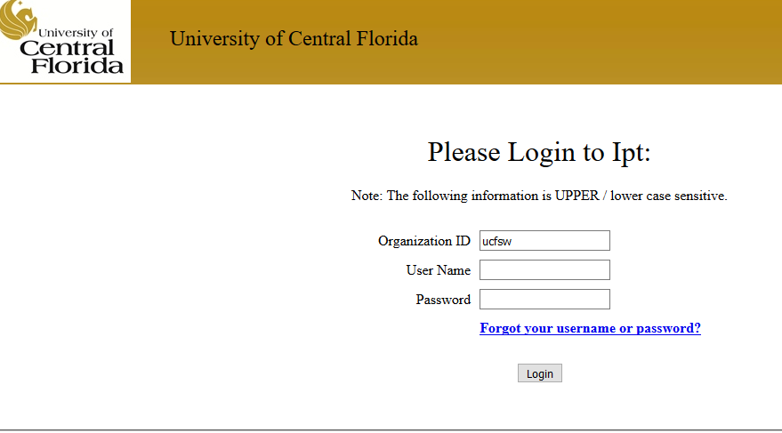
IPT – Getting Started
Access IPT at www.RUNIPT.com- Bookmark for use throughout the year.
Organizational ID: ucfsw
This is where you will access all necessary field forms.
You and your student will have access to the necessary forms and will sign electronically on documents.

Slide 26
IPT-Field Forms
All four forms are found on IPT
Found under the “my forms” tab on the Home page
Record of Field Hours
Supervisory Log
Learning Contract
Semester Evaluation of the Student

Slide 27
IPT- Field Forms
Record of Field Hours
Student will input their hours weekly into IPT.
Agency Field Instructor initials; verifying hours worked each week
Only enter completed hours. Do not project ahead.
Form will be reviewed weekly by the UCF Field Seminar Instructor
Do not sign the form until the end of the semester. Once your sign it, it becomes LOCKED
What if there is a mistake recorded on the form?
Corrections can be made in the “other hours earned” column
Reach out to the Field Office for assistance

Slide 28
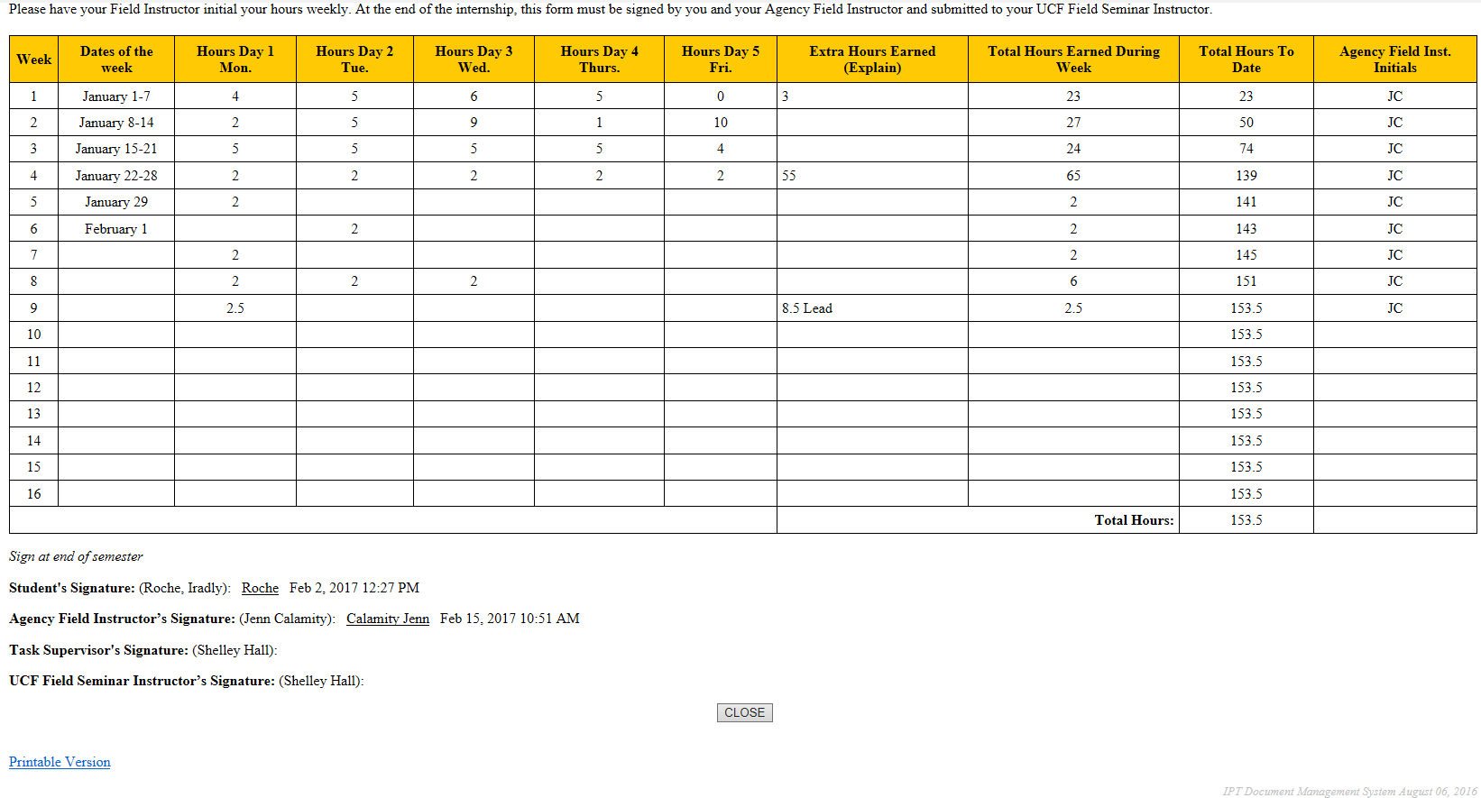
IPT- Record of Field Hours

Slide 29
IPT- Supervisory Log
Supervisory Log
Students will input the topics discussed during supervision onto the Supervisory Log.
Supervisor initials the supervision hours weekly
Each line of the log needs to have content. Please put N/A on any blank lines. The form cannot be signed off with blank lines.
The Supervisor & Student sign at the bottom at the end of the year
Note: Signing off on the form, locks the form.
** Zoom Poll

Slide 30
IPT- Supervisory Log

Slide 31
IPT- Field Forms
Learning Contract
One document for all semesters
Completed by student with guidance/input from Agency
Field Instructor
Should be realistic, specific, achievable with target
dates for completion
Must identify specific core competencies as specified
by the CSWE
Students must complete at least one task per
behavior
Students must provide Field Instructor with a copy

Slide 32
Learning Contract (Blank)

Slide 33
IPT- Learning Contract (Sample)

Slide 34
Field Documents & Student Assignments
Field Evaluations:
** Change Alert: **
Agency Field Instructor’s Evaluation will NOT be completed/submitted electronically through IPT this year.
All Evaluations will be completed using the FCAI (Foundation curriculum assessment instrument). A link for the FCAI will be sent to you in April.
ALL evaluations must be completed by the Agency Field Instructor (Not the students) & then reviewed with the student. The forms will be signed and then provided to the seminar instructor for upload into IPT.
As in all social work practice: Start where the student is and offer an honest assessment

Slide 35
FCAI- Semester Evaluation of the Student
Students must receive a score of 3 or above( satisfactory performance on each practice behavior) in order to pass field seminar. Scores below a 3 will require a Performance Improvement Plan developed with the student, Agency Field Instructor and Field Liaison.
Agency Field Instructor will complete the evaluation & review it with the student
All documents must be signed by the student and Field Instructor.
Once you have signed the document, please email the evaluation to the seminar instructor.

Slide 36
Accreditation Standards in Field Education
Set forth by the Council on Social Work Education (CSWE)
Educational Policies and Accreditation Standards (EPAS)
9 Core Competencies and
31 Component Behaviors
Accreditation standards incorporated into Field Seminar, Field Placement Experience and Field Education documents

Slide 37
Accreditation Standards in Field Education
CSWE - Educational Policies and Accreditation Standards (EPAS 2015)
Nine Core Competencies
1. Demonstrate Ethical and Professional Behavior |  | 6. Engage with Individuals, Families, Groups, Organizations, and Communities
2. Engage Diversity and Difference in Practice |  | 7. Assess Individuals, Families, Groups, Organizations, and Communities
3. Advance Human Rights and Social, Economic, and Environmental Justice |  | 8. Intervene with Individuals, Families, Groups, Organizations, and Communities
4. Engage in Practice-informed Research and Research-informed Practice |  | 9. Evaluate Practice with Individuals, Families, Groups, Organizations, and Communities
5. Engage in Policy Practice

Slide 38
Evaluation of Student & Performance Improvement Plans
Evaluation - ongoing activity throughout the field placement
Issues with student performance should be swiftly addressed by Agency Field Instructor so resolution can be achieved
If resolution is not successful, Agency Field Instructor should inform the Field Liaison and/or Director of Field Education immediately
Agency Field Instructor urged to contact Field Office early to support and assist in the process
Performance improvement plan:
Offers support to both the agency and the student
Importance of documentation

Slide 39
Questions:
Any questions so far regarding:
Field Forms
Roles in Field
When or how to reach out for assistance

Slide 40
Your Student: What You Can Expect
Feelings of anxiety and excitement at the same time during initial weeks of internship
May “cling to you like Velcro” at first but do wish to become independent
Have attended a thorough orientation to Field Education

Slide 41
Field Information Provided to Students
Importance of field placement…
Where social work comes alive; start of professional career
Presents multiple opportunities to become part of the professional social work community; network
Put learning into practice; develop social work skills
Opportunity to establish professional reputation; leading to professional references and job opportunities
Poor performance at your field placement can have negative consequences as a developing professional

Slide 42
Field Information Provided to Students
Students are expected to always behave in a professional behavior (polite, respectful attitude)
Punctual; always able to locate if necessary
Positive attitude during supervision
Use of appropriate title for supervisor (do not call your supervisor by his/her first name)
Appropriate dress
Personal hygiene
Strong work ethic
View self as agency employee; team player

Slide 43
Field Information Provided to Students
The relationship between student and Agency Field Instructor is always professional not personal
This is a great opportunity to practice establishing and navigating boundaries.
Do not socialize (including on social media) with Agency Field Instructor outside of field placement unless it is a work event
Create & maintain professional boundaries
Your supervisors are also social workers in the field & carry their own caseloads and supervisees.
They may need to negotiate time with you.

Slide 44
Field Information Provided to Students
Insurance and liability :
Under NO circumstances is a student to transport a client in personal vehicle
Students are covered by Liability Insurance by the University of Central Florida
Students are NOT covered by worker’s compensation by their agency in the event of an injury on the job
Students are strongly encouraged to carry health insurance

Slide 45
Field Information Provided to Students
Social Media & Technology
Texting while at field placement is unacceptable
Students are prohibited from using Facebook, Instagram, Vine, Twitter or other social media sites while at field placement
It is unacceptable to “friend request” Field Instructor/Task Supervisor
Paying bills online or completing other personal tasks while at internship is not permitted

Slide 46
Agency Time-off/Holiday/Vacation Policies
Students MUST discuss time off expectations and needs in advance (and obtain approval) with appropriate agency staff
Students follow the expectations/calendar of the agency and not the academic calendar
Holidays are based on the agency’s holiday calendar not the academic calendar
Students do not accrue field placement hours during holidays, or during lunch hours.

Slide 47
Attendance
Establish a regular schedule with your agency Field Instructor/Task Supervisor
Do not be late for your field placement
If delayed for a legitimate reason, you are sick or if there is an emergency, immediately inform field agency or designated contact
It is unacceptable to miss hours at your field agency due to studying, exams or assignments due
Absenteeism and/or tardiness will negatively impact the grade received for Field Education course & be cause for a PIP or agency termination.

Slide 48
Yearly Events:
Field Appreciation Celebration-April 2022
12-Hour Supervisor Course-Feb 2022
Free to all agency supervisors
12 CEU’s (minimal charge for those requesting CEU’s)
This training meets the requirements for Qualified Supervisor Training (supervise registered interns)

Slide 49
Certificate of Participation (tuition voucher)
Forms available today and will also be emailed to you in Spring semester
Please complete and return them to the field office within 2 weeks of the end of the semester in which your student finishes the field placement
Good for 6 credit hours of tuition at any state university
Good for 3 years from date of issue
Can only be issued one time (cannot be replaced if lost)
If the field instructor does not want to use the tuition voucher, it can be given to the task supervisor IF the task supervisor has played an active role in the student’s internship (signed documents, participated in the site visit, etc.)

Slide 50
Sincere Appreciation From Field Office
THANK YOU for your ongoing commitment to be a Field Instructor for our students – we cannot achieve success without you!

